Slide 1




Whole Foods Site Selection
Confirming published site selection guidelines and identifying un-reported selection variables using demographics from the U.S. Census Bureau

Slide 2


Research Questions
Does the Census Data confirm the published site selection methodology?
Does the Census Data suggest that there are additional variables that Whole Foods uses to select store locations?

Slide 3
General Approach
Utilize the store location coordinates for Whole Foods stores in Ohio to identify census tracts within a 20-minute drive
Build a data set of demographics for all Ohio census tracts
Explore the correlation between demographics and site selection

Slide 4

Whole Foods
Whole Foods has published site selection guidelines for commercial property owners, as follows:
Typically, 200,000 people or more in a 20-minute drive time
25,000-50,000 Square Feet
Large number of college-educated residents
Abundant parking available for our exclusive use
Stand alone preferred, would consider complementary
Easy access from roadways, lighted intersection
Excellent visibility, directly off of the street
Must be located in a high traffic area (foot and/or vehicle)
Source: Whole Foods Market - Real Estate

Slide 5
Census Tract Demographics
Census data for Ohio was gathered from the American Community Survey (ACS - 2020) at the tract level to identify population, educational attainment, income levels and household status (presence of families & children)
Educational attainment is available as an experimental ACS table S1501
Population, income, and household status are on the ACS 5-year Detailed Tables
The data was merged at the tract level and further joined with an indicator of the presence of a Whole Foods within a 20-minute drive

Slide 6
Mapping
Purpose: To provide a Geographic Visualization/Analysis of the Educational Attainment and Total Population within a 20 Minute Drive Time of Whole Foods Market Locations
Approach: Scraped Whole Foods Market locations from Google Maps API Downloaded ACS 5 Year EA Census Data and Joined the Data to Ohio Census Tracts Calculated Whole Foods 20 Minute Drive Time Network Analysis using the MapBox API Clipped Census Tracts that fell completely within the 20 Minute Drive Time Polygons Exported the Ohio Census Tract Centroids with Associated Data and Lat/Long Coordinates
Outcomes: Geographic Data can now be Analyzed in a Python Coding Environment Geographic Representations of the Data can now be Visualized in a Mapping Application

Slide 7
Q1: Does the Census Data confirm the published site selection methodology? Ronalds Conclusion
Observations: From a Visual Analysis of the Map Data Utilizing the Sum of Total Population Widget: It seems that all 11 Whole Foods Market Locations in Ohio have a Total Population of 200,000 or more People Within a 20 Minute Drive Time. Also, Utilizing the Average Educational Attainment Percentage Widget: It seems areas surrounding these locations show a significant presence of College-Educated Residents, typically 30-50% in the surrounding area. Therefore, the Census Data confirms that the Whole Foods Market locations in Ohio adhere to the published Site Selection Methodology, validating the criteria of Population Size and Educational Attainment for their Store Placements.

Slide 8
Q1: Does the Census Data confirm the published site selection methodology?
The census data for tracts that are within a 20-minute drive time versus those that are outside of the drive time perimeter supports the hypothesis that Whole Foods is targeting areas of high educational attainment.
The five highest correlations to the presence of a Whole Foods store:
S1501_C01_013E: Population 25 years and over - Graduate or professional degree 0.183959
S1501_C01_005E: Population 18 to 24 years - Bachelor's degree or higher 0.180090
S1501_C01_015E: Population 25 years and over - Bachelor's degree or higher 0.162479
B11005_017E: Nonfamily households without people under 18 years 0.148082
S1501_C01_012E: Population 25 years and over - Bachelor's degree 0.134333

Slide 9
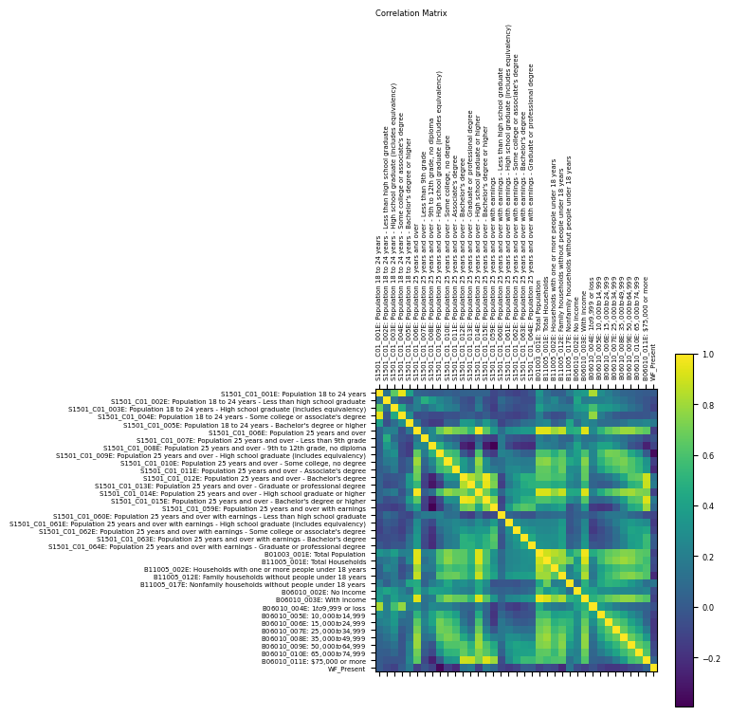
Q1: Does the Census Data confirm the published site selection methodology?
The five highest correlations to the presence of a Whole Foods store:
S1501_C01_013E: Population 25 years and over - Graduate or professional degree 0.183959
S1501_C01_005E: Population 18 to 24 years - Bachelor's degree or higher 0.180090
S1501_C01_015E: Population 25 years and over - Bachelor's degree or higher 0.162479
B11005_017E: Nonfamily households without people under 18 years 0.148082
S1501_C01_012E: Population 25 years and over - Bachelor's degree 0.134333

Slide 10
Q1: Does the Census Data confirm the published site selection methodology?
The five highest correlations to the presence of a Whole Foods store:
S1501_C01_013E: Population 25 years and over - Graduate or professional degree 0.183959
S1501_C01_005E: Population 18 to 24 years - Bachelor's degree or higher 0.180090
S1501_C01_015E: Population 25 years and over - Bachelor's degree or higher 0.162479
B11005_017E: Nonfamily households without people under 18 years 0.148082
S1501_C01_012E: Population 25 years and over - Bachelor's degree 0.134333

Slide 11
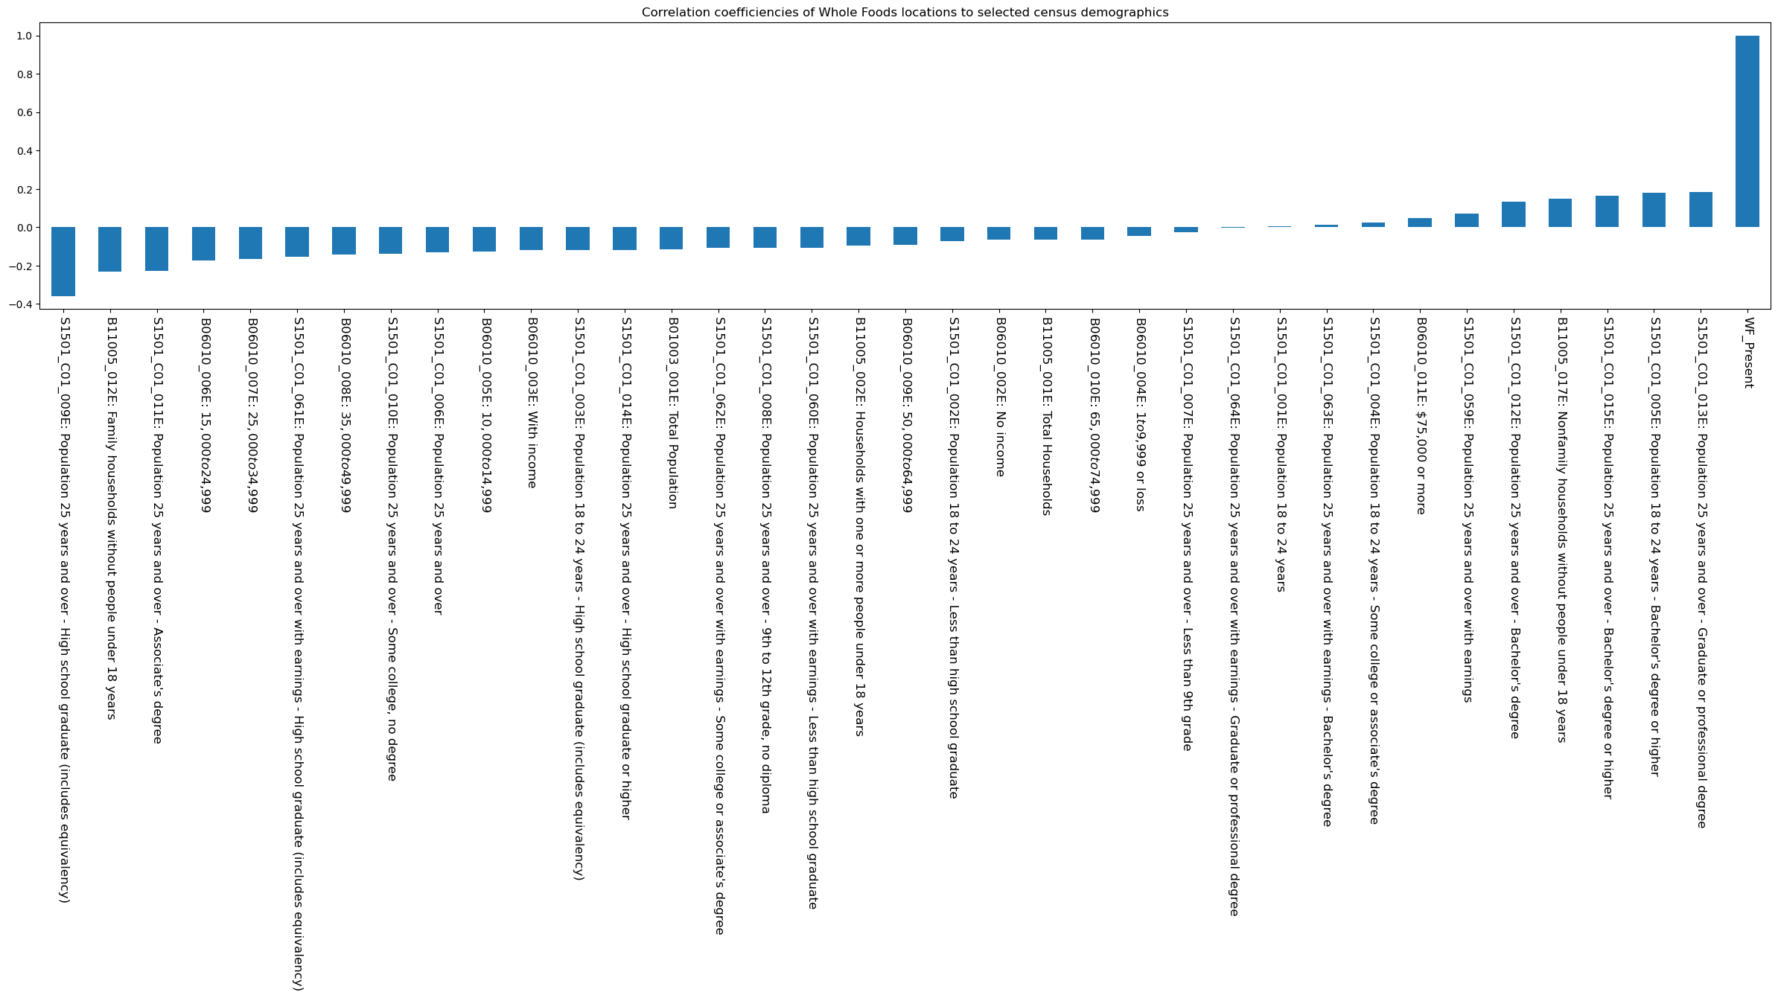
Q1: Does the Census Data confirm the published site selection methodology?
Educational attainment of population over 25:
S1501_C01_013E: Population 25 years and over – Graduate or professional degree 0.183959
S1501_C01_012E: Population 25 years and over – Bachelor's degree 0.134333
S1501_C01_006E: Population 25 years and over -0.129410
S1501_C01_010E: Population 25 years and over – Some college, no degree -0.138478
S1501_C01_011E: Population 25 years and over – Associate's degree -0.227191
S1501_C01_009E: Population 25 years and over – High school graduate (includes equivalency) -0.358078

Slide 12
Q1: Does the Census Data confirm the published site selection methodology?
Educational attainment of population over 25:
S1501_C01_013E: Population 25 years and over – Graduate or professional degree 0.183959
S1501_C01_012E: Population 25 years and over – Bachelor's degree 0.134333
S1501_C01_006E: Population 25 years and over -0.129410
S1501_C01_010E: Population 25 years and over – Some college, no degree -0.138478
S1501_C01_011E: Population 25 years and over – Associate's degree -0.227191
S1501_C01_009E: Population 25 years and over – High school graduate (includes equivalency) -0.358078

Slide 13
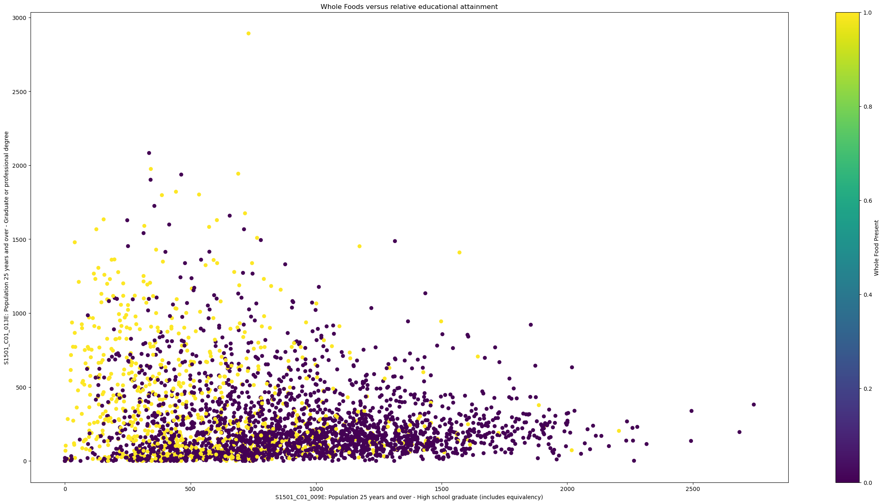
Q1: Does the Census Data confirm the published site selection methodology?
Expressing the variables of the highest and lowest correlation as the axes on scatter plot illustrates the site selection strategy
Census tract clusters with more than 500 people with graduate degrees and fewer than 1000 people with only high school diplomas may be attractive expansion opportunities

Slide 14
Q1: Does the Census Data confirm the published site selection methodology?
Expressing the variables of the highest and lowest correlation as the axes on scatter plot illustrates the site selection strategy
Census tract clusters with more than 500 people with graduate degrees and fewer than 1000 people with only high school diplomas may be attractive expansion opportunities

Slide 15
Q2: Does the Census Data suggest that there are additional variables that Whole Foods uses to select store locations?
Income Levels
B06010_006E: $15,000 to $24,999 -0.175441
B06010_007E: $25,000 to $34,999 -0.167236
B06010_008E: $35,000 to $49,999 -0.144412
B06010_005E: $10,000 to $14,999 -0.128237
B06010_009E: $50,000 to $64,999 -0.093677
B06010_010E: $65,000 to $74,999 -0.063824
B06010_004E: $1 to $9,999 or loss -0.045621
B06010_011E: $75,000 or more 0.047975

Slide 16
Q2: Does the Census Data suggest that there are additional variables that Whole Foods uses to select store locations?
Income Levels
B06010_006E: $15,000 to $24,999 -0.175441
B06010_007E: $25,000 to $34,999 -0.167236
B06010_008E: $35,000 to $49,999 -0.144412
B06010_005E: $10,000 to $14,999 -0.128237
B06010_009E: $50,000 to $64,999 -0.093677
B06010_010E: $65,000 to $74,999 -0.063824
B06010_004E: $1 to $9,999 or loss -0.045621
B06010_011E: $75,000 or more 0.047975
Correlation Between B06010_011E & S1501_C01_013E = 0.882824

Slide 17
Q2: Does the Census Data suggest that there are additional variables that Whole Foods uses to select store locations?
Families & Children
B11005_012E: Family households without people under 18 years -0.230345
B11005_002E: Households with one or more people under 18 years -0.096249
B11005_001E: Total Households -0.064691
B11005_017E: Nonfamily households without people under 18 years 0.148082

Slide 18
Further Analysis
Quantify/Analyze Building Square Footage Data Quantify/Analyze Stand Alone Complexes Quantify /Analyze Impervious Surface/Parking Data Quantify/Analyze Roadway Access and Lighting Quantify/Analyze Street Visibility/Viewshed Quantify/Analyze Traffic Data Quantify/Analyze Other Relevant Demographic Data Quantify/Analyze Census tract clusters with more than 500 people with graduate degrees and fewer than 1000 people with only high school diplomas for the State of Ohio

Slide 19

Discussion
ThePhoto by PhotoAuthor is licensed under CCYYSA.

